Slide 1
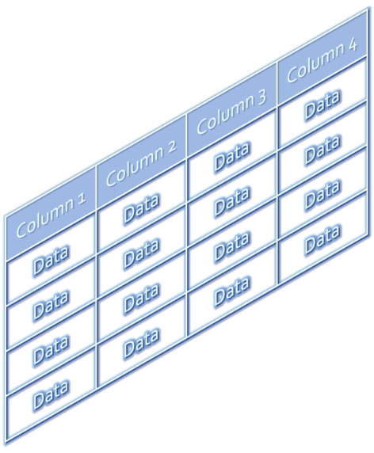
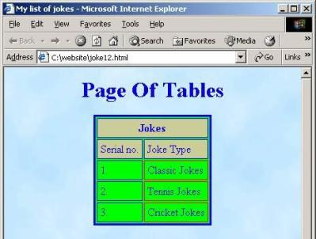



HTML Tables
HTML5
Telerik Software Academy
http://academy.telerik.com

Slide 2

Contents
HTML Tables
Simple Tables
Complete HTML Tables
Data cells and Header cells
Nested Tables
Complex tables
Cells Width
Cell Spacing and Padding
Column and Row Span

Slide 3
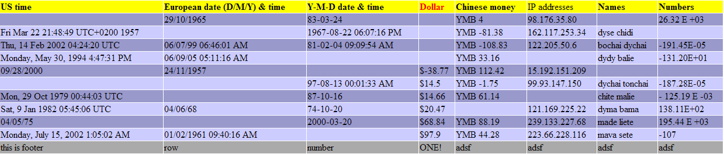
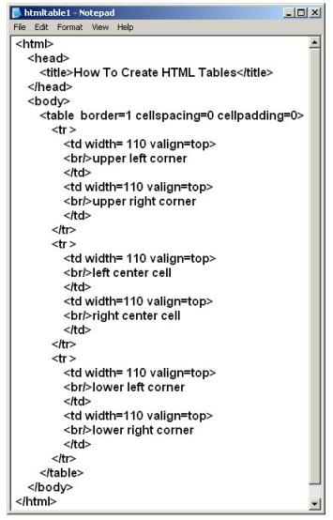
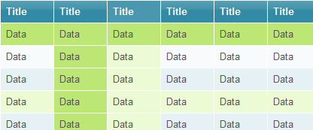
HTML Tables

Slide 4
HTML Tables
Tables represent tabular data
A table consists of one or several rows
Each row has one or more columns
Tables are comprised of several core tags:
<table></table>: begin/end table definition
<tr></tr>: create a table row
<td></td>: create tabular data (cell)
Tables should not be used for layout
Use CSS floats and positioning styles instead

Slide 5
Simple HTML Tables – Example
<table cellspacing="0" cellpadding="5">
<tr>
<td><img src="ppt.gif"></td>
<td><a href="lecture1.ppt">Lecture 1</a></td>
</tr>
<tr>
<td><img src="ppt.gif"></td>
<td><a href="lecture2.ppt">Lecture 2</a></td>
</tr>
<tr>
<td><img src="zip.gif"></td>
<td><a href="lecture2-demos.zip">
Lecture 2 - Demos</a></td>
</tr>
</table>

Slide 6

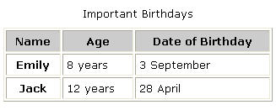

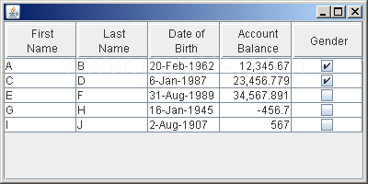
Simple HTML Tables
Live Demo

Slide 7
Data Cells and Header Cells
Two kinds of cells in HTML tables
Data cells – containing the table data
Header cells – used for the column names or some more important cells
Why two kinds of cells?
Used to semantically separate the cells
<tr>
<th>Full Name</th> <th>Mark</th>
</tr>
<tr>
<td>Doncho Minkov</td> <td>Very good (5)</td>
</tr>
<tr>
<td>Georgi Georgiev</td> <td>Exellent (6)</td>
</tr>

Slide 8


Data and Header Cells
Live Demo

Slide 9

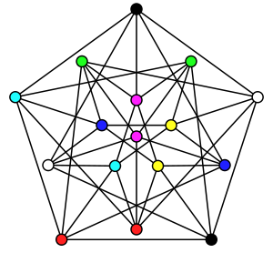

Complete HTML Tables
With Header, Footer and Body

Slide 10
Complete HTML Tables
Table rows split into three semantic sections: header, body and footer
<thead> denotes table header and contains <th> elements, instead of <td> elements
<tbody> denotes collection of table rows that contain the very data
<tfoot> denotes table footer but comes BEFORE the <tbody> tag
<colgroup> and <col> define columns (used to set column widths)

Slide 11
Complete HTML Table: Example
<table>
<colgroup>
<col style="width:100px" /><col />
</colgroup>
<thead>
<tr><th>Column 1</th><th>Column 2</th></tr>
</thead>
<tfoot>
<tr><td>Footer 1</td><td>Footer 2</td></tr>
</tfoot>
<tbody>
<tr><td>Cell 1.1</td><td>Cell 1.2</td></tr>
<tr><td>Cell 2.1</td><td>Cell 2.2</td></tr>
</tbody>
</table>
columns
header
th
footer
Last comes the body (data)

Slide 12
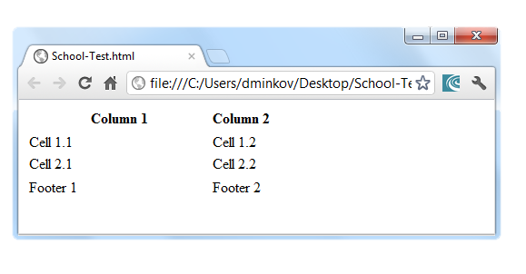
Complete HTML Table: Example (2)
<table>
<colgroup>
<col style="width:200px" /><col />
</colgroup>
<thead>
<tr><th>Column 1</th><th>Column 2</th></tr>
</thead>
<tfoot>
<tr><td>Footer 1</td><td>Footer 2</td></tr>
</tfoot>
<tbody>
<tr><td>Cell 1.1</td><td>Cell 1.2</td></tr>
<tr><td>Cell 2.1</td><td>Cell 2.2</td></tr>
</tbody>
</table>
table-full.html
Although the footer is before the data in the code, it is displayed last

Slide 13


Complete HTML Tables
Live Demo

Slide 14


Nested Tables
Tables in Tables in Tables in Tables…

Slide 15
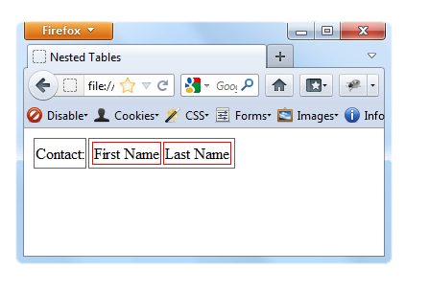
Nested Tables
Table "cells" (<td>) can contain nested tables (tables within tables):
nested-tables.html
<table>
<tr>
<td>Contact:</td>
<td>
<table>
<tr>
<td>First Name</td>
<td>Last Name</td>
</tr>
</table>
</td>
</tr>
</table>

Slide 16
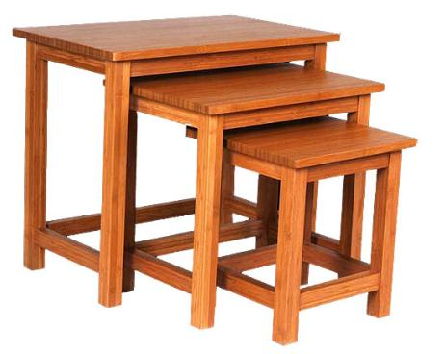
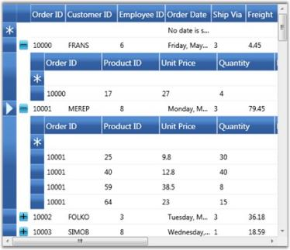
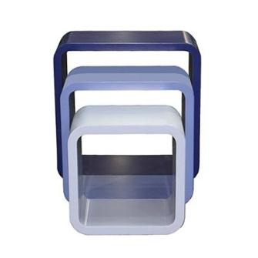
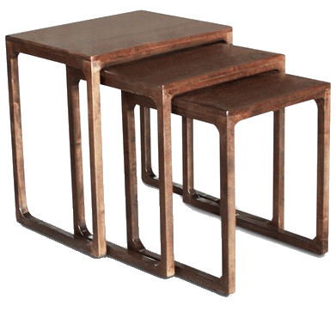
Nested Tables
Live Demo

Slide 17

Complex Tables
With Padding, Spacing and Stuff

Slide 18
Cell Spacing and Padding
Tables have two attributes related to space
cellspacing
Defines the empty space between cells
cellpadding
Defines the empty space around the cell content
cell
cell
cell
cell
cell
cell
cell
cell

Slide 19
Cell Spacing and Padding – Example
table-cells.html
<html>
<head><title>Table Cells</title></head>
<body>
<table cellspacing="15" cellpadding="0">
<tr><td>First</td>
<td>Second</td></tr>
</table>
<br/>
<table cellspacing="0" cellpadding="10">
<tr><td>First</td><td>Second</td></tr>
</table>
</body>
</html>

Slide 20
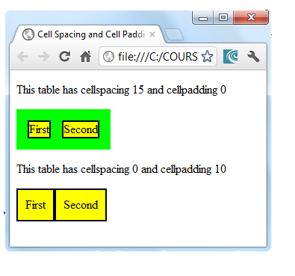
Cell Spacing and Padding – Example (2)
table-cells.html
<html>
<head><title>Table Cells</title></head>
<body>
<table cellspacing="15" cellpadding="0">
<tr><td>First</td>
<td>Second</td></tr>
</table>
<br/>
<table cellspacing="0" cellpadding="10">
<tr><td>First</td><td>Second</td></tr>
</table>
</body>
</html>

Slide 21
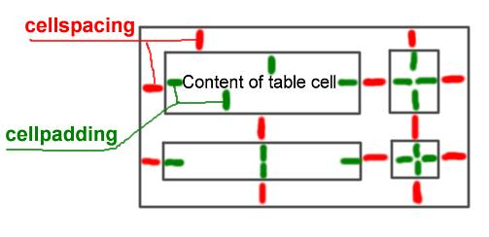
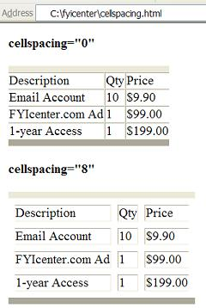
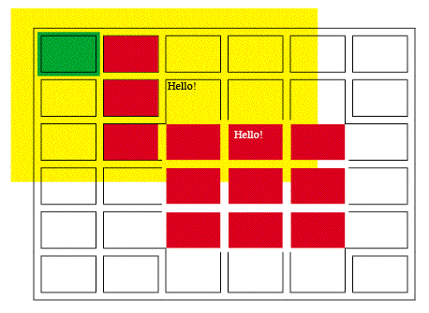
Cell Spacing and Cell Padding
Live Demo

Slide 22



Row and Column Spans
How to Make a Two-Cells Column or Row?

Slide 23
Column and Row Span
Cells have two attributes related to merging
colspan
Defines how many columns the cell occupies
rowspan
Defines how many rows the cell occupies
colspan="1"
colspan="1"
rowspan="2"
rowspan="1"
cell[1,1]
cell[1,2]
cell[1,1]
cell[1,2]
cell[2,1]
cell[2,1]
colspan="2"
rowspan="1"

Slide 24
Column and Row Span – Example
table-colspan-rowspan.html
<table cellspacing="0">
<tr class="1">
<td>Cell[1,1]</td>
<td colspan="2">Cell[2,1]</td>
</tr>
<tr class="2">
<td>Cell[1,2]</td>
<td rowspan="2">Cell[2,2]</td>
<td>Cell[3,2]</td></tr>
<tr class="3">
<td>Cell[1,3]</td>
<td>Cell[2,3]</td><
/tr>
</table>

Slide 25
Column and Row Span – Example (2)
table-colspan-rowspan.html
<table cellspacing="0">
<tr class="1">
<td>Cell[1,1]</td>
<td colspan="2">Cell[2,1]</td>
</tr>
<tr class="2">
<td>Cell[1,2]</td>
<td rowspan="2">Cell[2,2]</td>
<td>Cell[3,2]</td></tr>
<tr class="3">
<td>Cell[1,3]</td>
<td>Cell[2,3]</td><
/tr>
</table>
Cell[1,1]
Cell[2,1]
Cell[1,2]
Cell[2,2]
Cell[3,2]
Cell[1,3]
Cell[2,3]

Slide 26
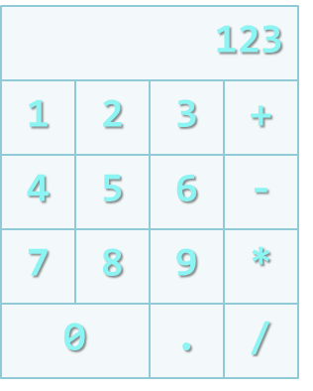
Row and Column Spans
Live Demo

Slide 27
HTML – Tables and Forms
http://academy.telerik.com

Slide 28




Free Trainings @ Telerik Academy
"Web Design with HTML5, CSS3 and JavaScript" course @ Telerik Academy
html5course.telerik.com
Telerik Software Academy
academy.telerik.com
Telerik Academy @ Facebook
facebook.com/TelerikAcademy
Telerik Software Academy Forums
forums.academy.telerik.com

